Slide 1
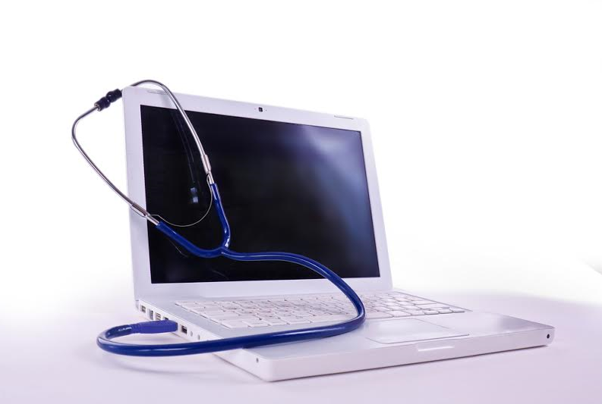
Becker’s Hospital Review 2nd Annual Health IT + Leadership + Pharmacy 2019
May 4, 2019
Nursing Informatics (NI)
The significant role NI has within technology

Slide 2
Presenter
Holly E. Gauthier-Wetzel MSN, BSN, RN-BC, COI
PhD Candidate in Nursing Education
Walden University, Minneapolis, MN
Nursing Informatics Specialist
Coordinator: Barcode Medication Administration
Veteran Affairs Medical Center, Charleston, SC
Holly.Gauthier-Wetzel@va.gov

Slide 3
Objectives
Examine the role of Nursing Informatics
Outline Relationship between Nursing Informatics and Information Technology
Discuss communication methods

Slide 4
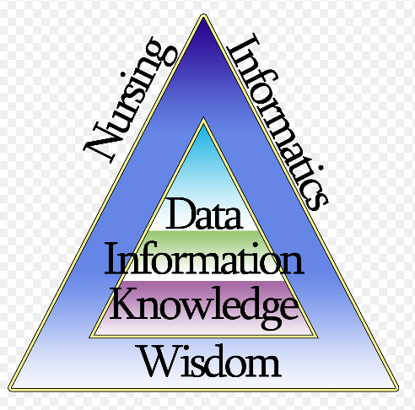
Nursing Informatics
Is a combination of cognitive science, computer science, information science, and nursing science ~
and includes the development, analysis, and evaluation of information systems augmented by technology created to support, enhance and manage patient care (AMIA, 2018).

Slide 5
Nursing Informaticists are…
Communication Experts
Multidisciplinary
Clinically Experienced
Medical Terminologists
Project Managers
System design
Lifecycle
Integration
Testing
Committee Spokespersons
Patient Advocates
Safety
Privacy
Information Security Managers
Data Analysts
Inventory Managers
Policy & Procedure Developers
Documentation Specialists
Educators
Compliance Experts
Agency, Local, and National

Slide 6
Informatics Competencies
All Nurses have some
degree of Informatics
experience
INNOVATOR
Mastery of expert skills and use technology in design, plan and coordinate technologies and theories
Clinical
Informatics
MODIFIER
Demonstrates intermediate NI competencies
Mastery of user level skills
Uses technology in inventive ways in their practice
Novice to Expert Nurse
Management
& Research
USER
Demonstrates core NI competencies.
This is the basic level that ALL nurses should minimally demonstrate
Frontline
Nursing Care
Notes:
Novice: The Novice or beginner has no experience in the situations in which they are expected to perform. The Novice lacks confidence to demonstrate safe practice and requires continual verbal and physical cues. Practice is within a prolonged time period and he/she is unable to use discretionary judgement.
Advanced Beginner: Advanced Beginners demonstrate marginally acceptable performance because the nurse has had prior experience in actual situations. He/she is efficient and skillful in parts of the practice area, requiring occasional supportive cues. May/may not be within a delayed time period. Knowledge is developing.
Competent: Competence is demonstrated by the nurse who has been on the job in the same or similar situations for two or three years. The nurse is able to demonstrate efficiency, is coordinated and has confidence in his/her actions. For the Competent nurse, a plan establishes a perspective, and the plan is based on considerable conscious, abstract, analytic contemplation of the problem. The conscious, deliberate planning that is characteristic of this skill level helps achieve efficiency and organization. Care is completed within a suitable time frame without supporting cues.
Proficient: The Proficient nurse perceives situations as wholes rather than in terms of chopped up parts or aspects. Proficient nurses understand a situation as a whole because they perceive its meaning in terms of long-term goals. The Proficient nurse learns from experience what typical events to expect in a given situation and how plans need to be modified in response to these events. The Proficient nurse can now recognize when the expected normal picture does not materialize. This holistic understanding improves the Proficient nurse's decision making; it becomes less labored because the nurse now has a perspective on which of the many existing attributes and aspects in the present situation are the important ones.
Expert: The Expert nurse has an intuitive grasp of each situation and zeroes in on the accurate region of the problem without wasteful consideration of a large range of unfruitful, alternative diagnoses and solutions. The Expert operates from a deep understanding of the total situation. His/her performance becomes fluid and flexible and highly proficient. Highly skilled analytic ability is necessary for those situations with which the nurse has had no previous experience.

Slide 7
Vision Support Nursing Practice
Skills, tools and environment to support patient care
Skills, tools and information to manage resources
Data needed to develop evidence for patient care and policy
Researchers
Information necessary to establish policy
Program Offices
Front Line Nursing Knowledge
Nurse Managers
.and Executives

Slide 8
Strategic Framework

Slide 9
Information Technology
IT projects do not have a start and end point.
The electronic health record created clinical transformation.
Allowing for continuing quality improvement.

Slide 10
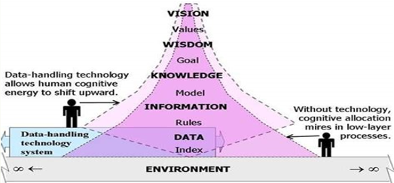
Nursing Informatics & Information Technology
NIs support nurses, consumers, patients, and the interprofessional healthcare team, with decision-making
This support is accomplished through the use of information structures, information processes (work flows), and information technology.

Slide 11
Nursing Informatics & Information Technology
Clinicians need to be present while new technology systems are designed, during each stage of record development, to provide a more holistic view of patient care demands and workflow.
The clinicians need to have the ability to ‘speak the language’ of technology.
By working together, they help to define clinical objectives and how these objectives can be achieved within the electronic health record.

Slide 12
Appointing Nurse Informatic Leaders
Strengthen the clinical aspects of IT projects.
Speak both languages:
nursing and IT
Bridge the gap between
IT and clinical communities
Engage nurses and IT.
Resulting in…
Patient care transformed by data…
Measurable outcomes

Slide 13
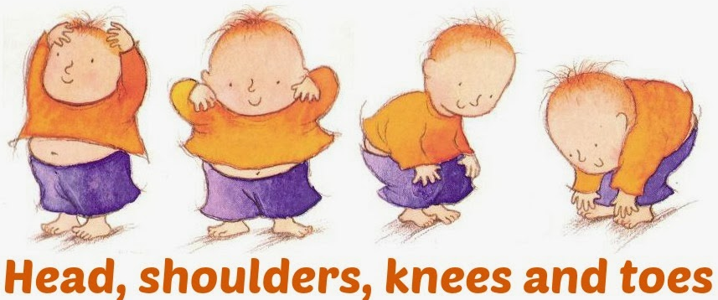
Information Technology & Nursing Informatics Communicate and Collaborate
IT programmers would find it appropriate to alphabetize the dropdown menu within the electronic health record…..
Head
Knees
Shoulders
Toes
Nursing staff complete a “Head to Toe” assessment – requiring a head to toe dropdown menu within the electronic health record
Head
Shoulders
Knees
Toes

Slide 15
References
American Medical Informatics Association. (2018). Retrieved from https://www.amia.org/programs/working-groups/nursing-informatics
American Nurses Association. (2015). Nursing informatics: Scope and standards of practice (2nd ed). Silver springs, MD

