Slide 1
The Evolving Use of IT to Improve the Patient Experience
M. Bridget Duffy, MD Chief Medical Officer Vocera Communications
Twitter: @DuffyCXO

Slide 2
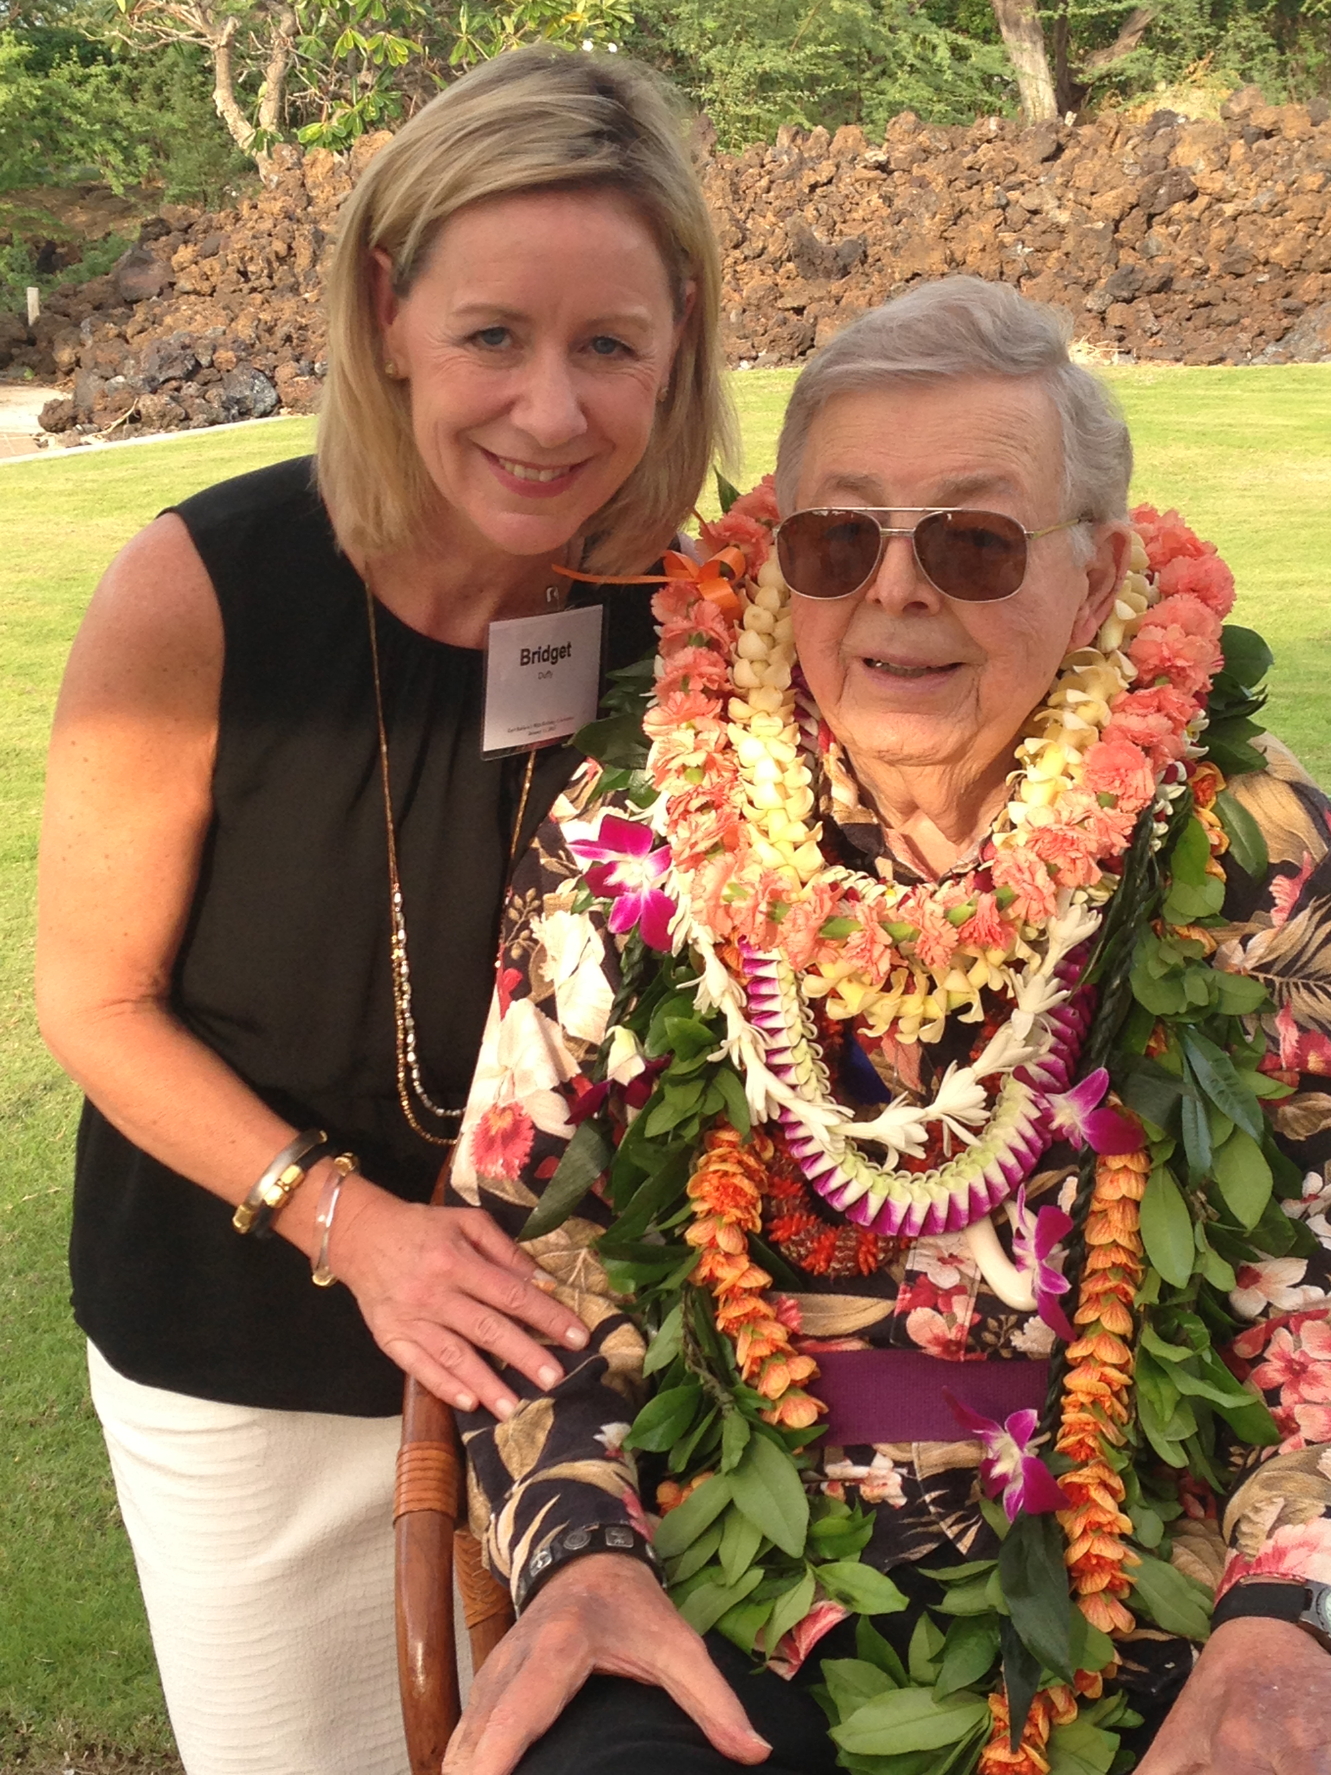
“We must focus on innovations that improve humanity.”
– Earl Bakken
Founder of Medtronic Inventor of the Pacemaker

Slide 3
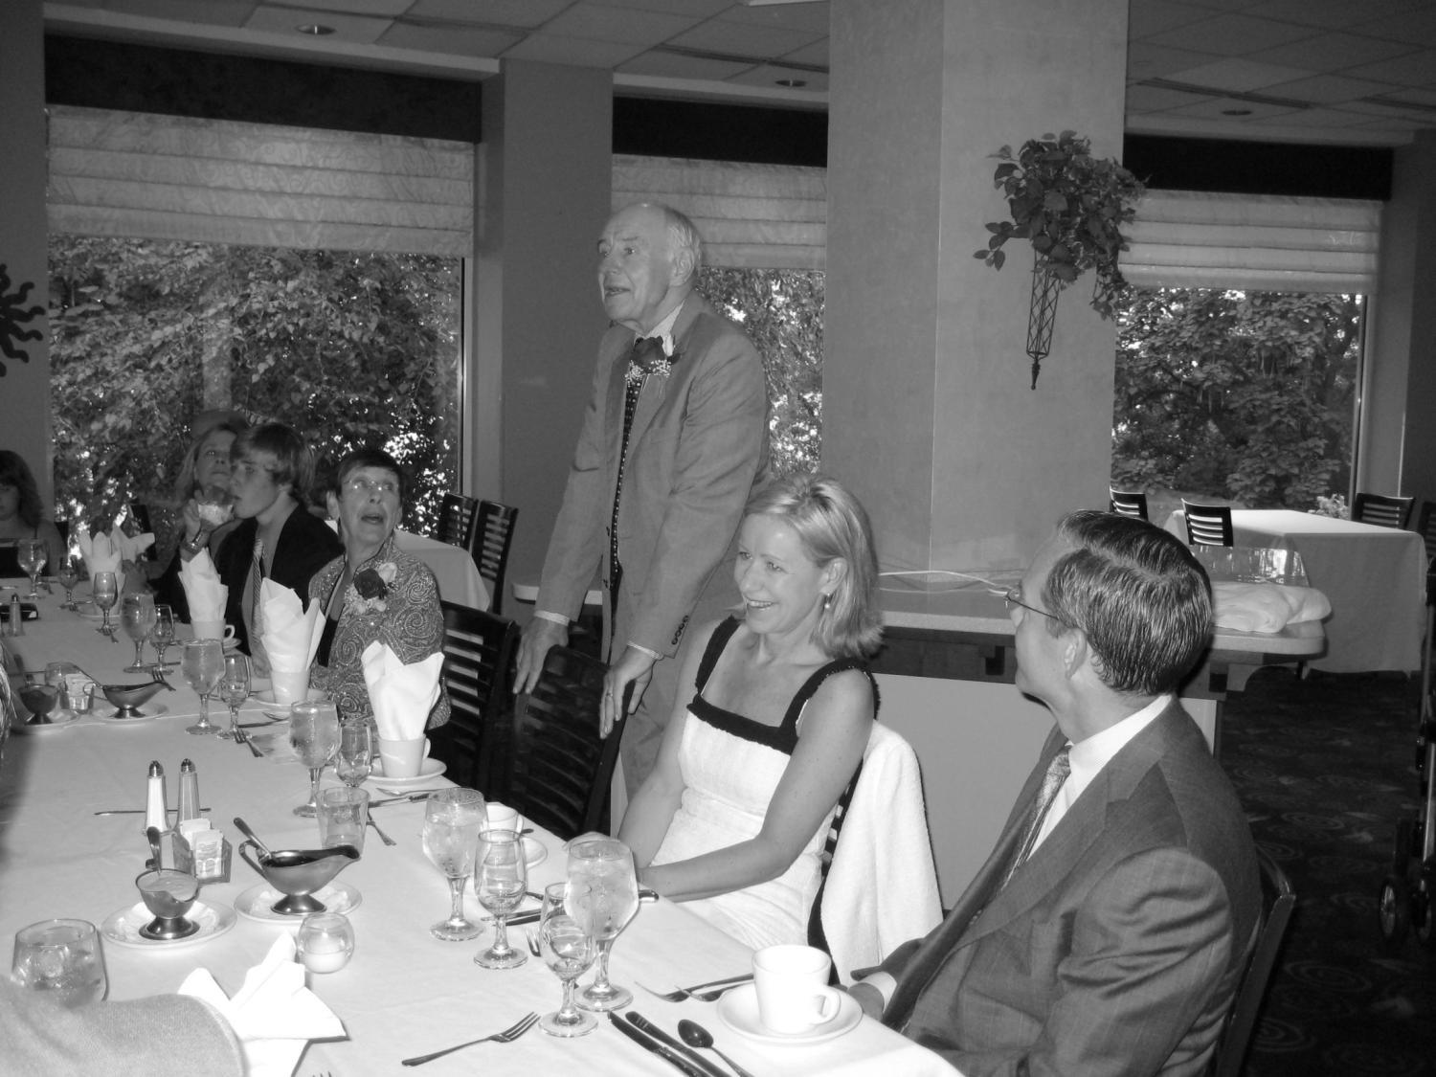
Notes:
Why am I doing this…

Slide 4
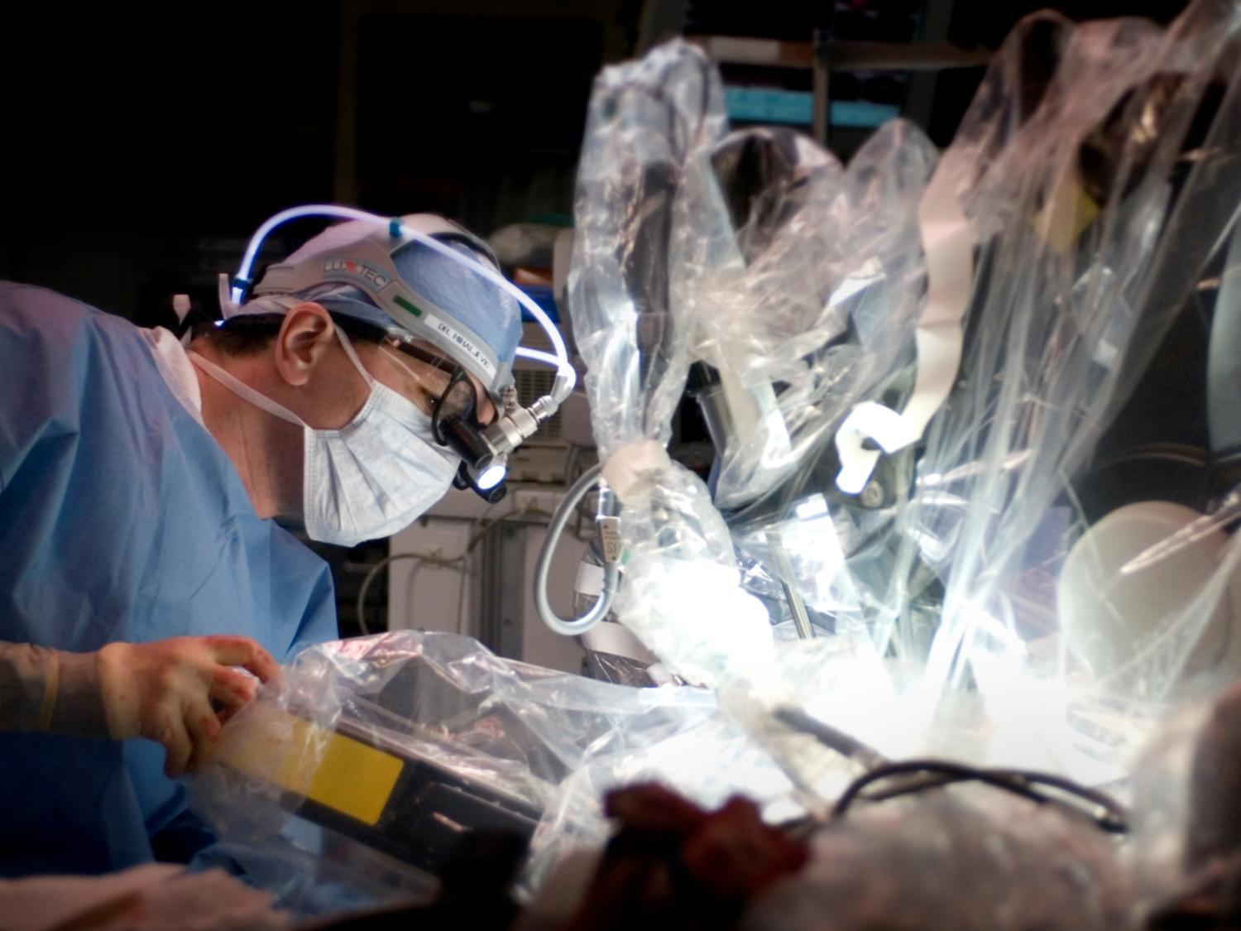
Notes:
Heart Surgery in India – I can walk in and operate without ever meeting the family
Why was medicine better in India
Spirituality at the core of healing
Medical team worked as a unit – dinner together
True relationship with patient

Slide 5
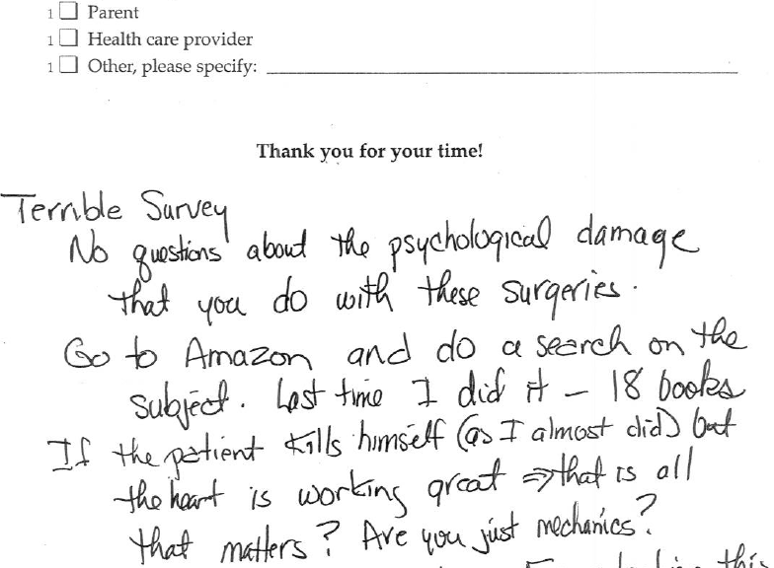

Slide 6
CXO Roundtable
Notes:
CXO Roundtable
Convened a group of thought leaders together from across the country and Canada to set fix what is broken in healthcare and design the next standards in care.
Approximately 30 leaders with the title Chief Experience Officer.

Slide 7
Innovation Partners

Slide 8
Quadruple Aim
Person-Centered
Cost
Quality
Joy

Slide 9
Wellbeing Checklist
Reconnect people to purpose
Address emotional and spiritual needs
Improve physician and nurse relationship
Create a healing environment
Enable peak performance

Slide 10
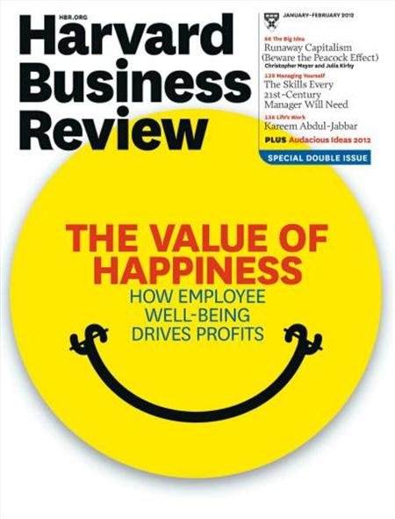
Optimize Physician and Nurse Wellbeing

Slide 11
Are You Disruptive?

Slide 12
Physician Empathy Curve
Medical
School
Medical
School
Nearing Retirement
Nearing Retirement
Practicing
Practicing
Adapted from Hojat, M., Mangione, S. Nasca, T.J. &. Gonnella, J.S. (2005). Empathy scores in medical school and ratings of empathic behavior 3 years later. Journal of Social Psychology, 145 (6), 663-672.

Slide 13
Imperatives for Transformation
1
Align experience with quality and safety.
2
Build a relationship-based culture.
3
Infuse the voice of patients and families.
4
Map the gaps in efficiency plus empathy.
5
Put science behind the human experience.

Slide 14
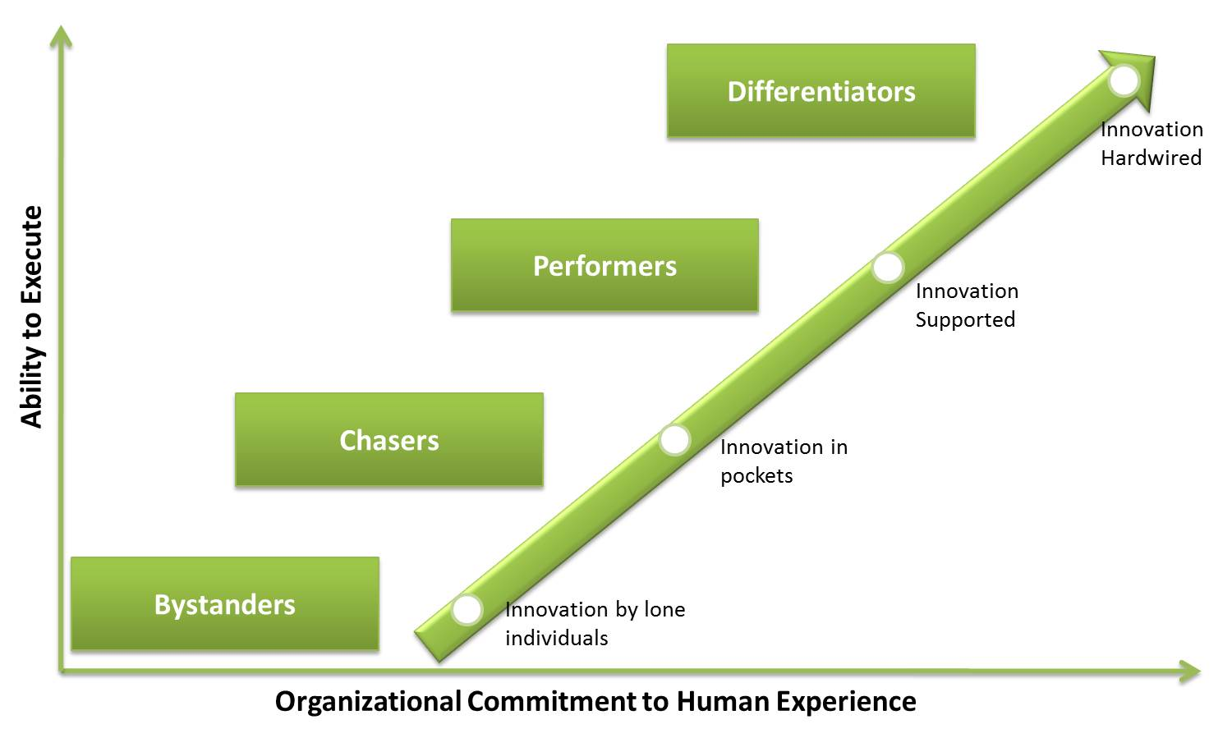
Levels of Experience Differentiation
Notes:
CXO Roundtable
Convened a group of thought leaders together from across the country and Canada to set fix what is broken in healthcare and design the next standards in care.
Approximately 30 leaders with the title Chief Experience Officer.

Slide 15
“We are increasingly feeling like assembly line workers. That is ok for my car-it does not notice and has no experience.”
Notes:
We are increasingly feeling like assembly line workers. That is ok for my car-it does not notice and has no experience.

Slide 16
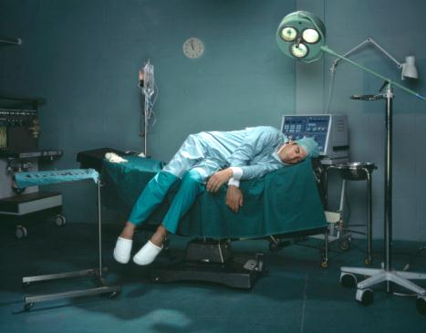
Exhaustion

Slide 17
Is Technology Making Us Less Human?
© 2011 Thomas G. Murphy, M.D.
Notes:
Physician’s Name is Thomas G. Murphy, M.D. – 2011. No one was more surprised than the physician himself. The drawing was unmistakable. It showed the artist-a 7-year-old girl-on the examining table.
Her older sister was seated nearby in a chair, as was her mother, cradling her baby sister. The doctor sat staring at the computer, his back to the patient-and everyone else. All were smiling. The picture was carefully drawn with beautiful colors and details, and you couldn't miss the message. When he saw the drawing, the physician wrote a caption for it: "The economic stimulus bill has directed $20 billion to health care information technology, largely funding electronic medical record incentives. I wonder how much this technology will really cost?"

Slide 18
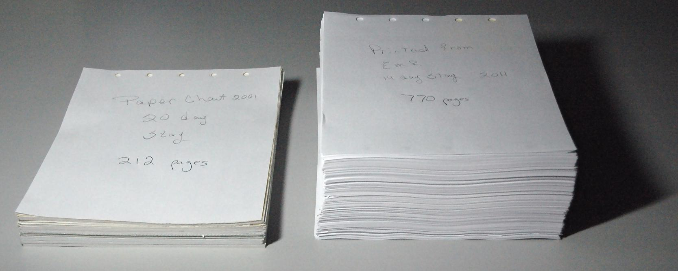
Meaningless Use
20 Day Stay 2001
212 Pages
14 Day Stay 2011
770 Pages
Notes:
Association with suicidal ideation, substance abuse, automobile accidents, marital and family discord

Slide 19
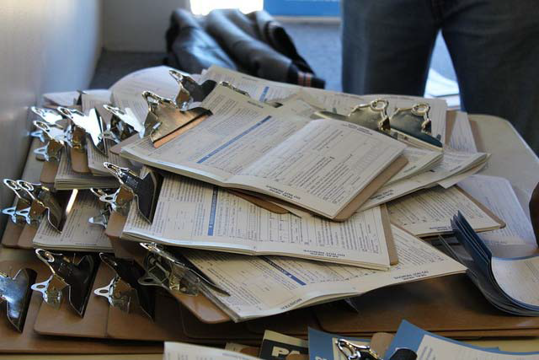
Databases?

Slide 20
Apathy

Slide 21
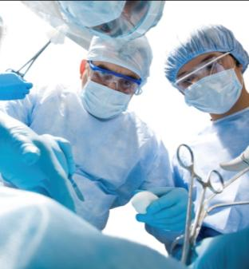
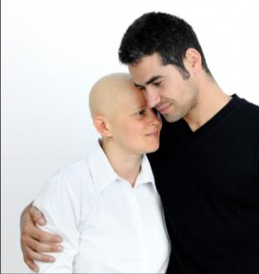
The Key to the Ideal Experience
Lean
Experience Mapping
+
Human Experience
Efficiency
=
+
Empathy
=
Communication, Relationship, Emotions
Quality, Safety, Flow
Loyalty and Growth
Notes:
As Karen discussed, VSM is a process focusing on efficiency and reducing waste as a means of driving quality and safety. Efficiency is Important – having effective, functional processes in place is essential to providing a good experience.
Building on lean principles, Experience Mapping focuses on two things:
Differentiation – experience mapping focusing on going beyond what is expected, and creating a unique experience.
Connection – experience mapping looks at the human-to-human interactions, touch points, and gaps to identify solutions.
As we partner across the next few days, we will identify the ‘Moments of Truth”, those moments that elicit powerful emotional responses and establish always events, or standards of care, to ensure our patients and families have a uniquely positive experience, every time they come for care

Slide 22
1. Build Infrastructure for Change
President
Chief Medical Officer
Chief Nursing Officer
Executive Medical Director, Experience
Executive Director, Experience
Program Director,
Care Experience
Patient Navigator
Experience Intelligence
Experience Improvement and Innovation
Friends and Family Program
Quality
Safety
Experience
Notes:
Service match science

Slide 23
2. Create a Relationship-Based Culture
Moved from 65th to 85th percentile rating in “top box” physician communication scores
Lowered risk-adjusted mortality to < 0.8%
*Less than 24 months
Notes:
In less than 24 months, Mission Health boosted its physician communication scores from the 60th to the 85th percentile in the “top box” rating, the most positive response category in Hospital Consumer Assessment of Healthcare Providers and Systems (HCAHPS) measures.
Moved risk adjusted mortality rate to under 0.8%, which puts it in the top 16 percent of healthcare organizations in the United States for observed and expected mortality

Slide 24
3. Listen to Patient and Family Voice
Notes:
Aligning for Continuous Improvement
The Functional teams work together to make a model for continuous improvement. Supporting root cause analysis, development of solutions, and measurement of results.

Slide 25
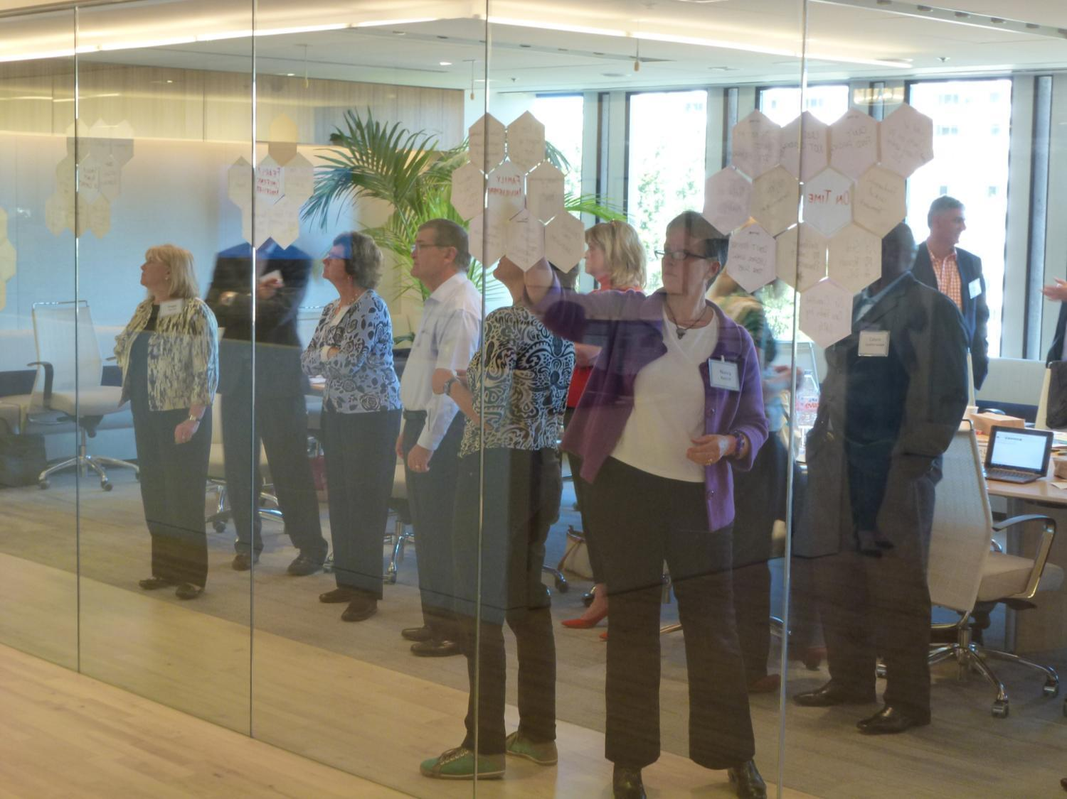
Design Human-Centered Solutions

Slide 26
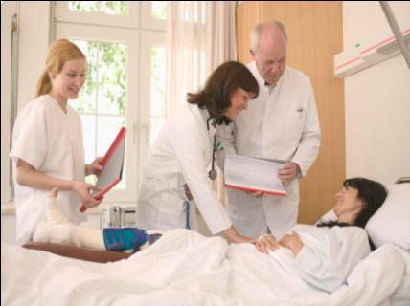
4. Map the Human Experience
First Impression
Care Coordination
Last Impression
Access and Registration
Patient and Family Friendly Communication
Connectivity that Creates Patients for Life

Slide 27
5. Put Science Behind the Human Experience
Notes:
Service to Match the Science

Slide 28
Differentiate with Always Events® Checklist
Address patients’ emotional and spiritual needs
Put nurses and doctors back at the bedside
Improve physician and nurse communication
Engage patients and families in plan of care
Create consistent seamless journeys

Slide 29
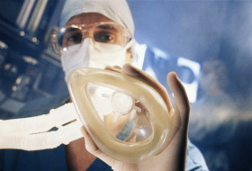
First Impressions
Notes:
Viktor Krebs

Slide 30
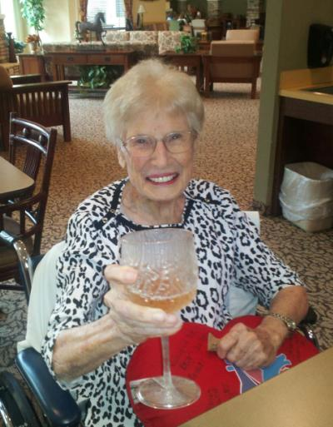
Informed Hope
Case Study:
Patient Name: Dorothy
Age: 94 Years Old
Procedure: Aortic Valve Surgery
Goal 1-Week Post Op: Return to water aerobics four days a week and toast her kids with champagne on her 94th birthday.

Slide 31
Code Lavender™
Notes:
1514 Patients at CCHS HVI

Slide 32
Code Lavender™
“Likelihood to recommend” as a place to work.
163% increase*
*Within 6 months
Notes:
Net Promoter Scores among physicians and nurses also skyrocketed post implementation:
“How likely are you to recommend Lucile Packard Children's Hospital as a place to work?”: 163% improvement
“How likely are you to recommend Lucile Packard Children's Hospital as a place for patients and families to come for care?”: 36.7% improvement

Slide 33
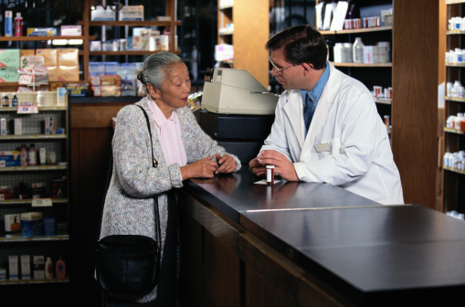
Moments of Truth
Notes:
Communicate – listen to their voice, hear them, value their input on what matters most to customers and share information about the organization often and broadly.
Liberate – your employees. Free them from hierarchy and bureaucracy that gets in the way of them doing their job.
Respect – treat everyone as an equal and valued member of the team.
Believe – give them something to believe in that is greater than the task at hand. Connect them to the purpose of the organization.
Grow – give them a reason to grow, stretch their capabilities so they bring greater value to the organization.
Heart of the House – insure that the “back of house” for the employees is as serene and re-energizing as it is for the customers you serve.
Walk in their shoes – be present and visible and acknowledge what they do. Have empathy for what it takes to do their job.
Build Team – do not ask someone to do something that you would not do yourself. Team means jumping in to do a task even if it’s “not my job”.
Relationships – encourage your employees to build relationship and connection with customers. Create an emotional connection that builds loyalty.
Give back to the community – support and encourage your employees to care for the community in which they live.

Slide 34
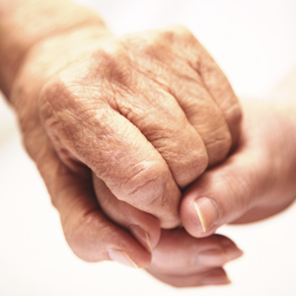
Sacred Moment
Notes:
In additional to providing a safe, high quality clinical experience, organizations must treat the whole human by supporting the spiritual and emotional components of healing.
I’m certain now that we benefit from the Sacred Moment as much as the patient. When the call came, it was a crazy day (as always) and I was trying to figure out how to fit it in. Dreading how much it would set me back, I went upstairs to find my patient. I dug down deep in my pocket for a smile and walked in. The patient had just been brought to the recovery room and all he wanted was an ice chip. How would it feel to want one ice chip more than anything in this world? I was forced to think about what had me so stressed. My problems seemed ridiculous compared to this man’s. I quickly became focused on the patient’s needs. I then slowed down to spend time with a family that was going through a tough day. I met them on the floor, gathered extra seating, and made sure we had the family member’s phone numbers down as well as the pastor’s. It really gives you perspective and reminds you that the people are why you loved healthcare. The alarms, computers, charts, ringing phones and call lights are all forgotten for that moment and you are just visiting with some new friends. I entered the room focused on me and left focused on others. Most people achieve this respect for basic human needs while on mission trips in other countries. We are surrounded by these basic needs every day, but distractions blind us to them. The Sacred Moment opens our eyes to those needs. My smile didn’t go back in my pocket that day and I am grateful for the experience!

Slide 35
Sacred Moment
Patients ‘Likelihood to Recommend’
72%
44%
31%
November 2011
December 2011
May
2013
Pre
Post
Notes:
Patient likelihood to recommend
Trend upward continues. First quarter of 2014, Twin Rivers is 71% higher as compared to 2011!

Slide 36
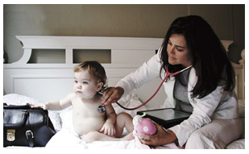
Empathy Hardwired
Empathy Rounds

Slide 37
Empathy Rounds
39%* increase in ‘likelihood to recommend’
2,858 staff compliments captured in 4 months
*Within 12 months
Notes:
Timeframe for likelihood stat: Feb. 2013 compared to Feb. 2014
Using care rounds technology to proactively capture the voice of the patient in real time and hardwired process of rounding.
Real-time Nurse Leader Rounding Nov. 2013-Feb. 2014
32 units
Total Rounds: 11,803
Staff Recognitions: 2,858
Follow-up Requests: 395
69% of leader rounded patients rated overall experience “very good”
Nov. 2012-Feb. 2013: 12%
Nov. 2013-Feb. 2014: 51%

Slide 38
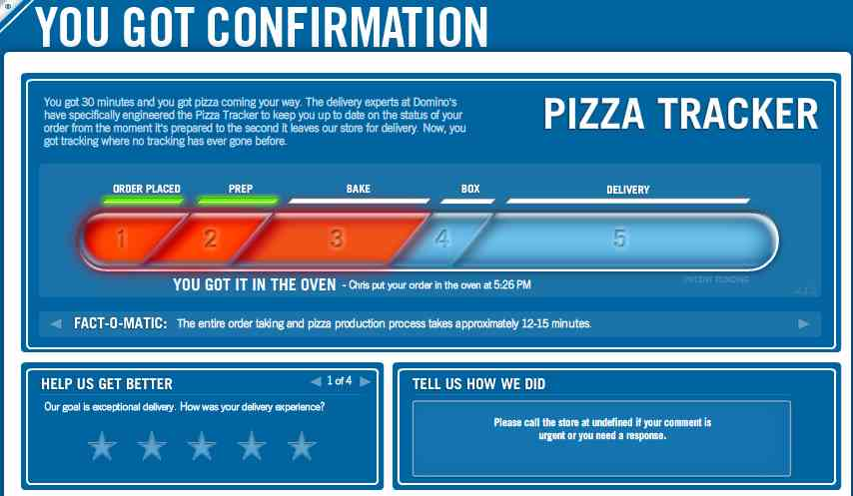
Data Tracker

Slide 39
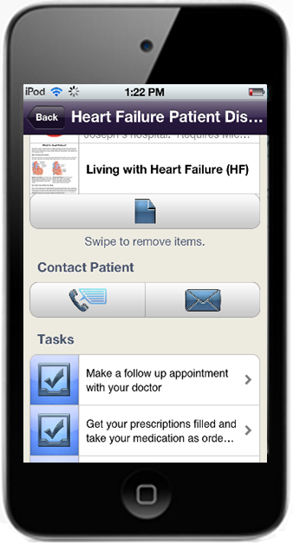
Post Care Connectivity
15% reduction in readmissions
63% increase in patient satisfaction
*Within 6 months

Slide 40
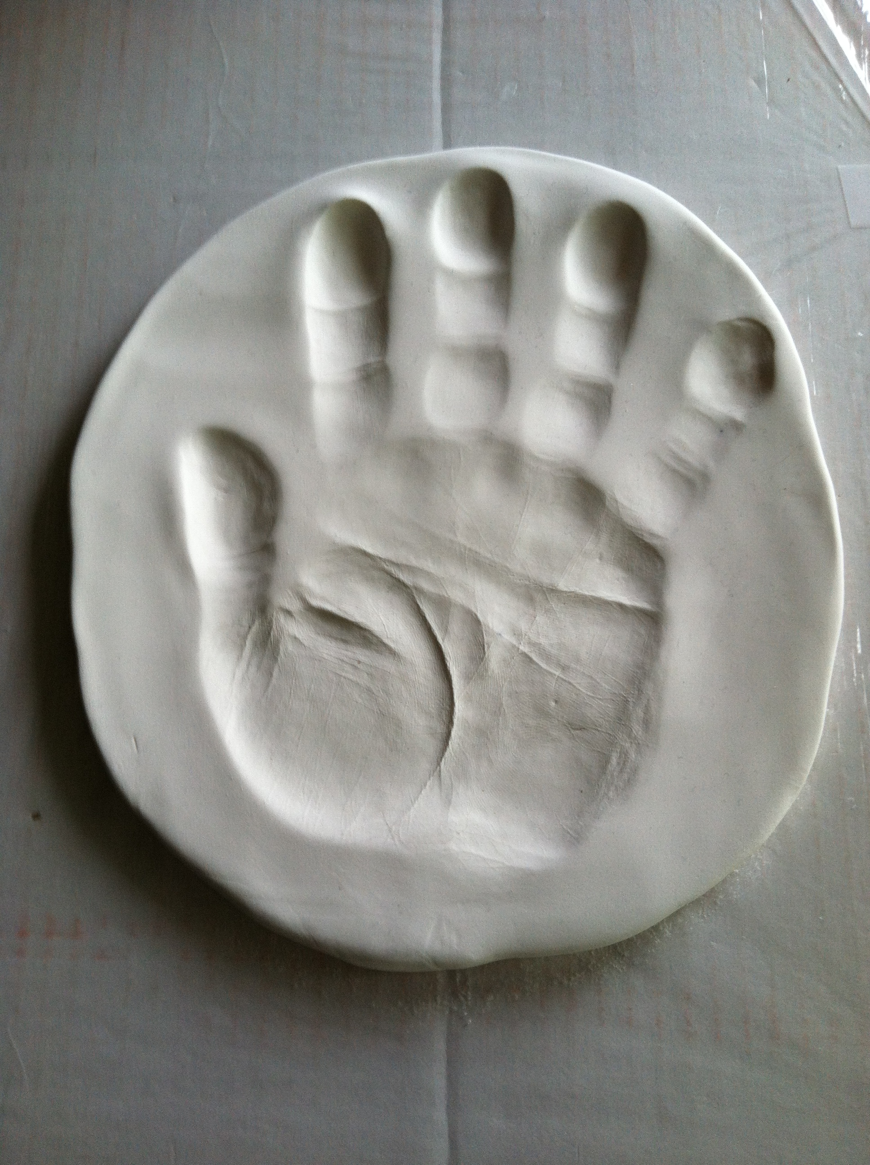
Lasting Impressions

Slide 41
“True Innovation Improves the Human Experience.” – Alexander Blass
Notes:
“True Innovation Improves the Human Experience” – Alexander Blass
Design - Map the patient experience from wing-to-wing, understanding the emotional experience, as well as, the physical and clinical
Solutions - Implement solutions based on patient voice, addressing the elephants in the room!
Culture - Every employee is a caregiver, and their level of engagement and empowerment can make or break the patient experience.

Slide 42
Contact
M. Bridget Duffy, MD
Chief Medical Officer, Vocera
www.vocera.com
Twitter: @DuffyCXO
Copyright ©2014. Vocera Communications, Inc.

