Slide 1
Top 10 Game Changers in Healthcare IT
(or “how to talk” HC IT)
Marion K. Jenkins, PhD, FHIMSS
Becker’s Hospital Review
May 2014
Built to Optimize…

Slide 2
Outline
Overview of 3t
Current state of healthcare IT
Top ten game changers
Q/A and discussion
Built to Optimize…

Slide 3
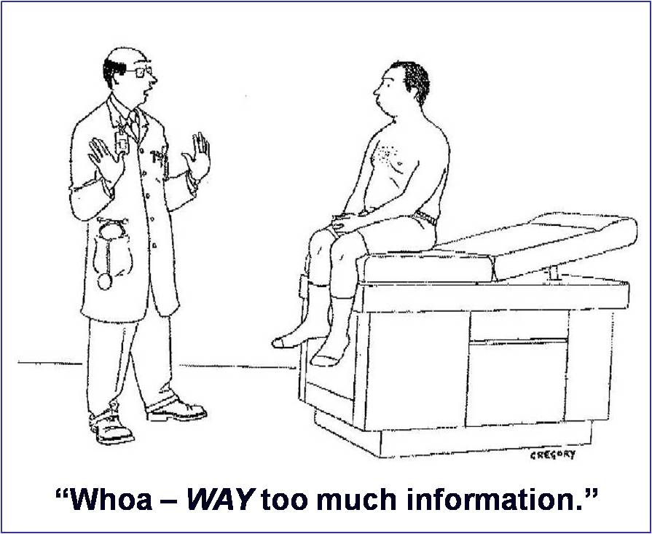
My challenge today:
Built to Optimize…

Slide 4
Overview of 3t Systems
20 year history in IT consulting and managed services
10 year history in “cloud” (long before it was called that)
Healthcare specialization (over 200 healthcare projects completed across the US)
Focus is on large medical practices, regional/community hospitals and other healthcare entities
3t was recently named to the top 100 Managed Service Providers in the world by Nine Lives Media/MSPMentor
Built to Optimize…

Slide 5
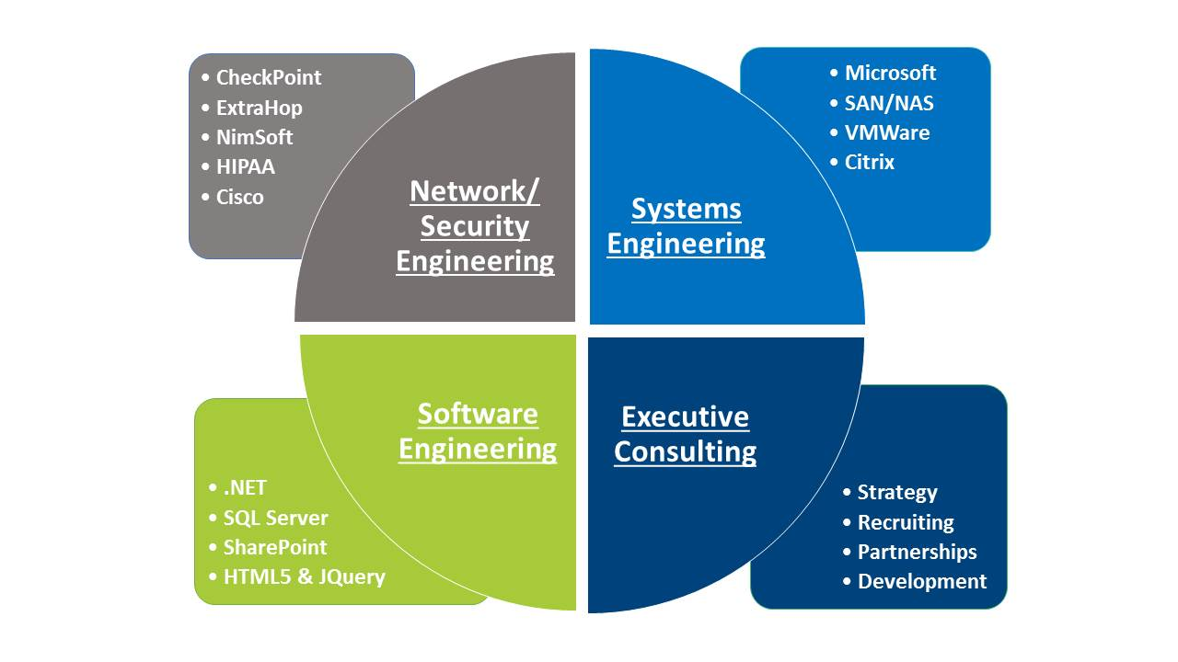
3t Systems’ areas of expertise
3t Systems focuses on IT infrastructure – the systems and components necessary to support EHRs, PACS, billing, messaging, data warehousing, etc.
Built to Optimize…

Slide 6
Current state of Healthcare IT
Healthcare continues to significantly lag other industries in automation and technology:
IT spending is still less than half that of other industries
Most industries are optimizing their 4th or 5th generation systems to gain additional efficiencies
HC is still arguing about whether IT is even a good idea
ARRA/HITECH has not moved the needle much towards increased adoption
Built to Optimize…

Slide 7
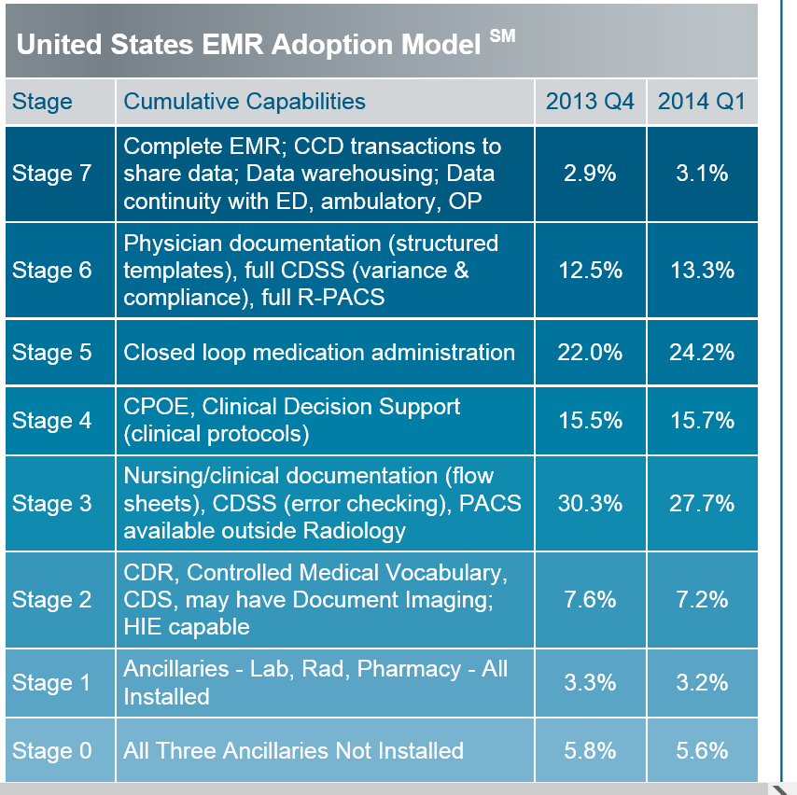
Current state of Healthcare IT
Acute Care – only 3% can share data
Built to Optimize…

Slide 8
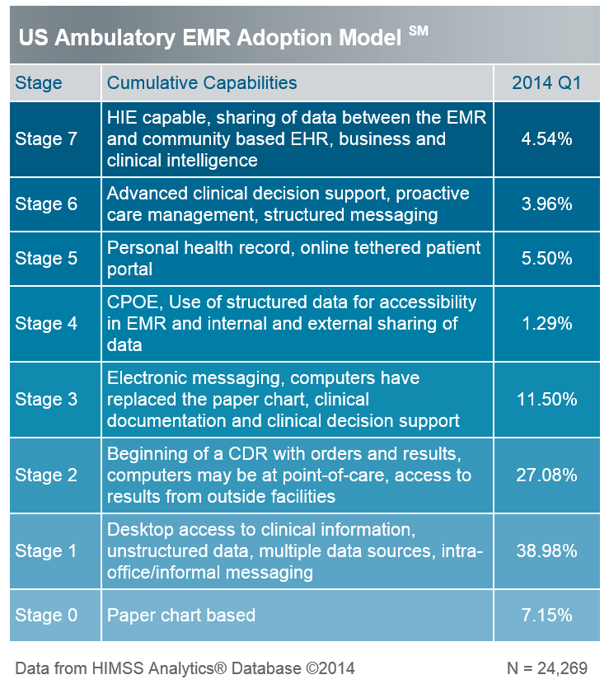
Current state of Healthcare IT
Ambulatory Care – less than 5% can share data
Built to Optimize…

Slide 9
What’s wrong with Healthcare IT?
Clinician dissatisfaction
Multiple applications
Numerous passwords
Slow login times
User resistance
Built to Optimize…

Slide 10
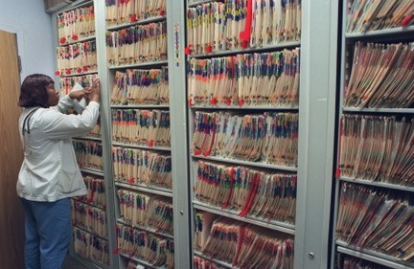
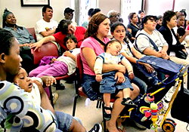
Other issues/current status
Millions spent yet HC IT systems underused
Many duplicate/paper processes still exist
Patient care suffers and costs increase
Other common symptoms:
Most IT help desk calls are password-related (low value to IT or the organization)
Unprecedented HIPAA Security breaches caused by user workarounds
Built to Optimize…

Slide 11
Top ten game changers in HC IT
HIPAA Security (REALLY???)
BYOD – Bring Your Own Device
Virtualization – desktop and server infrastructure
Business continuity/disaster recovery (BCDR)
Medical-grade cloud infrastructure
Built to Optimize…

Slide 12
Top ten game changers in HC IT
Patient impatience – the rise of the HC consumer
Technology obsolescence – Moore’s law 50 yrs on
HyperMobility in the clinical setting
Interoperability – the Rosetta Stone
Workflow-enabling technologies – Single sign-on, tap-to login, floating desktop
Built to Optimize…

Slide 13
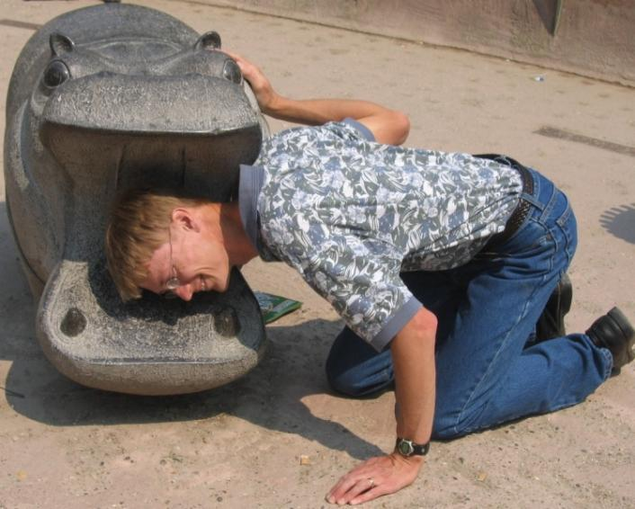
1. HPAA Security – REALLY???
HIPAA – You’re Doing it Wrong
Built to Optimize…

Slide 14
1. HPAA Security – REALLY???
After ~10 years, HIPAA has gotten increasingly worse:
From 2009-13, there were 600 breaches, involving 22 million patient records
Now there are nearly 1000 breaches, over 31 million records
Fines/penalties have increased from millions to billions
Increased scrutiny from HHS, State AGs, class action lawyers (waiting for the next John Grisham book…)
Built to Optimize…

Slide 15
HPAA Security – the facts
No breach has occurred within/because of EHRs
Roughly 80% of breaches have been caused or enabled by internal employees, because of poorly designed/configured/ maintained IT systems
Most breaches have occurred when “power users” – frequently doctors – have downloaded patient data to local devices or emailed it to themselves
Built to Optimize…

Slide 16
HPAA Security – what to do?
Become familiar with the HIPAA Security Rule (email the author for a 2-page summary of ~500 pages of government HIPAA regulations)
Recognize that HIPAA Security represents IT best practices
Do a REAL HIPAA Security Assessment (with real IT diagnostic tools, not a paper survey) (MRI for IT)
Built to Optimize…

Slide 17
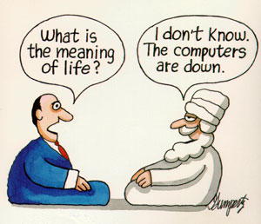
2. BYOD – Bring Your Own Device
Built to Optimize…

Slide 18
2. BYOD – Bring Your Own Device
In the “old days” (up until ~5 years ago) IT departments set standards for user devices (workstations, laptops)
With the advent of smartphones and tablets, users demanded their own device
IT departments now have to deal with wide variability of devices and systems while maintaining security, etc.
The genie is out of the bottle (and never going back)
Built to Optimize…

Slide 19
2. BYOD (cont)
Different platforms and systems stress an already stressed IT environment – support, security, etc.
Different devices have different “real estate” (screen size) and input methods (keyboard, touch screen)
Systems have to be optimized to work across all popular platforms (Windows, Android, Apple IOS)
Requires virtualization technologies (later topic)
Built to Optimize…

Slide 20
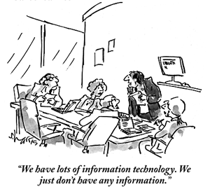
3. Virtualization – Servers
Built to Optimize…

Slide 21
3. Virtualization – Servers
Virtualization – making the IT system “think” that something is there that is not physically there
Old days (up until ~5 years ago):
Each application needed a server – A directory server, a mail server, an application server, a database server, etc.
As apps got bigger, they needed multiple servers (“server farm”)
As servers got bigger, you could “partition” them to handle multiple operating systems and apps…Voila! VIRTUALIZATION
Built to Optimize…

Slide 22
Advantages to Server Virtualization
“Level 1” benefits to virtualizing servers:
Save physical infrastructure – space, power, cooling
Make systems more fault-tolerant – able to recover a server “crash” easier by using snapshots, not just backups
Better utilization of capital resources – one big server costs less than many smaller equivalent ones
Better utilization of resources – memory, CPU, etc.
Built to Optimize…

Slide 23
Advantages to Server Virtualization
“Level 2” benefits to virtualizing servers
Ability to create fault-tolerant, replicated systems that better approach 100% uptime
Ability to do upgrades and maintenance on production systems with little or no impact
Requires more sophistication and multiple physical sites
Requires extra IT tools and increased expertise of IT staff
Necessary for business continuity/disaster recovery (later topic)
Built to Optimize…

Slide 24
Desktop Virtualization
VDI – Virtual Desktop Infrastructure
“Old days” (up until ~5 years ago) – Each workstation had its own operating system, hard disk drive software applications
Gave users lots of control but led to high maintenance and replacement costs
Desktop Virtualization consolidates desktop OS and other software to centralized servers (usually also virtualized)
Until recently (~2 yrs), VDI was still a PITA for users
Built to Optimize…

Slide 25
Desktop Virtualization - Advantages
Today’s (properly designed) VDI solutions:
Significantly reduce IT support and technology refresh costs
Optimize the use of bandwidth
Create a positive user experience
Eliminate (or significantly reduce) the most common HIPAA risks
Support BYOD
Built to Optimize…

Slide 26
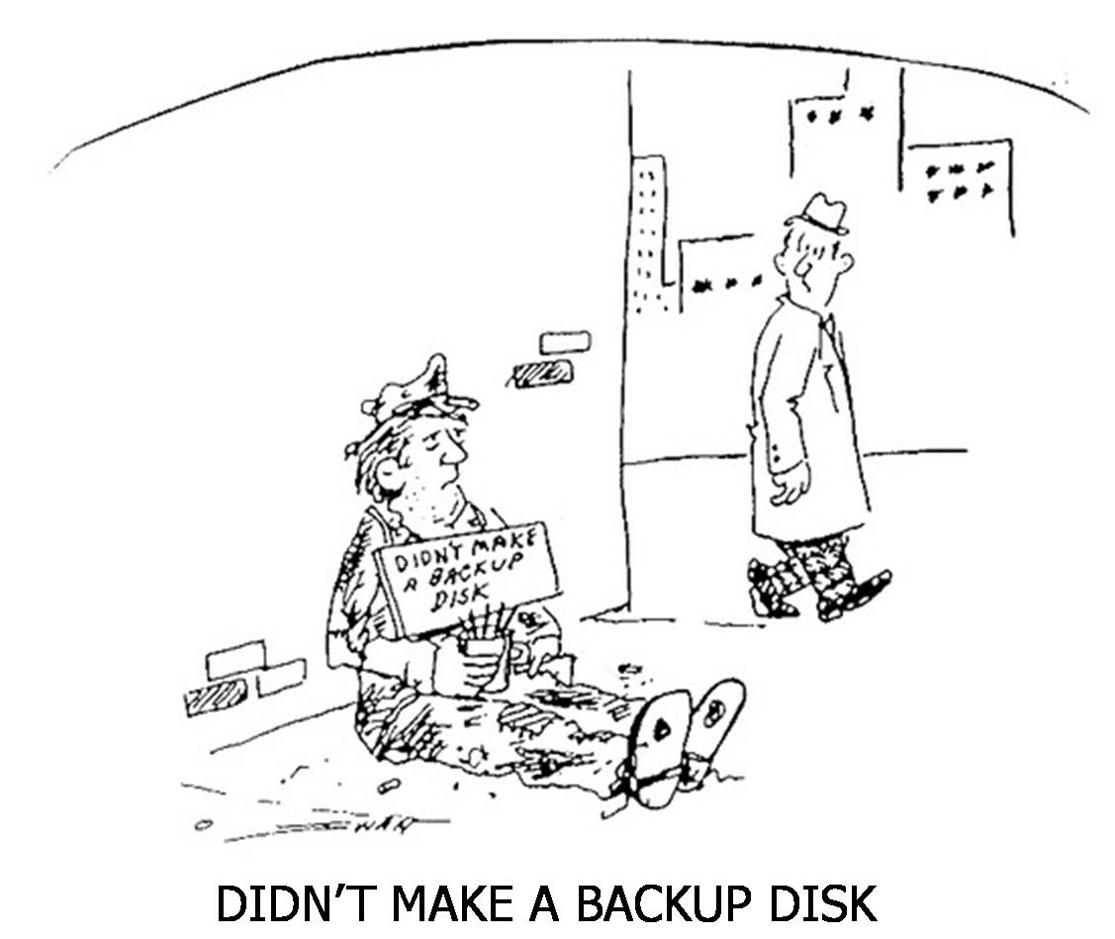
4. Business Continuity/Disaster Recovery (BCDR)
Built to Optimize…

Slide 27
4. Business Continuity/Disaster Recovery (BCDR)
Could be an entire day-long seminar/workshop itself
Frequently confused/misunderstood
Is a combination of hardware, software and procedures, combined with advanced planning and “what if” scenarios
Must be tested monthly/quarterly/annually or it’s worthless
Built to Optimize…

Slide 28
4. Business Continuity/Disaster Recovery (BCDR) – Key Concepts
Business Continuity is how you continue to operate (e.g., a battery backup in case the power goes out temporarily)
Disaster Recovery describes how you would avoid or recover from a disaster (e.g., Hurricane Rita, Moore, OK tornado)
RTO – Recovery Time Objective. How long it takes to recover and get systems back online.
RPO – Recovery Point Objective. The point from which the data is available (e.g., last night’s backup; last week’s backup)
Built to Optimize…

Slide 29
4. Business Continuity/Disaster Recovery (BCDR)
A warranty response time is neither an RTO or an RPO
Simplified example: You have an onsite Dell server and you have their best 4-hour warranty guarantee, and a component fails at 3 PM on a Tuesday. Assume it takes:
3 hours to troubleshoot and identify the problem
4 hours to get the part, and 2 hours to install it
Another 8 hours to restore from Monday night’s backup
You are up and running 8 AM Wednesday (assuming an all nighter)
Your RTO is 19 hours and your RPO is 32 hours (best case)
Usually this would be several days of lost time/lost data
Built to Optimize…

Slide 30
4. Business Continuity/Disaster Recovery (BCDR)
True BCDR is almost always prohibitively expensive to do on your own (need 2 complete sites with 2 of everything)
Cloud plus virtualization are usually the only reasonably cost effective way of achieving BCDR
Email the author for a BCDR process checklist
Built to Optimize…

Slide 31
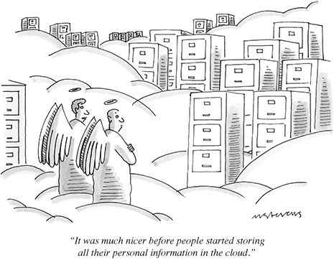
5. Medical-grade cloud
Built to Optimize…

Slide 32
5. Medical-grade cloud
Cloud is not new – it’s been around 30+ years
New broadband and virtualization technologies have significantly improved cloud in the last ~3 years
Cloud is not foolproof – it doesn’t solve all your IT problems
Not all cloud solutions are equal – public, private, hybrid
Relies heavily on advanced virtualization and IT management tools
Built to Optimize…

Slide 33
5. Medical-grade cloud
Cap-ex spending favors on-site (internal) IT
Op-ex spending favors cloud
Moore’s law favors cloud (obsolescence every 2-3 yrs)
A cloud-based EHR is not sufficient (essentially all HIPAA breaches occur through file/print/email etc.)
BCDR solutions are almost never possible other than through cloud solutions – the cost is astronomical
Built to Optimize…

Slide 34
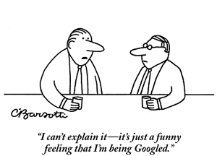
6. Patient Impatience
Built to Optimize…

Slide 35
6. Patient Impatience
The Rise of the Healthcare Consumer
Consumers are expecting (demanding) online communication with their healthcare providers
Web sites, patient portals, kiosk check-in, online scheduling are now considered minimum standards
Social networking is necessary but carries its own risks
Built to Optimize…

Slide 36
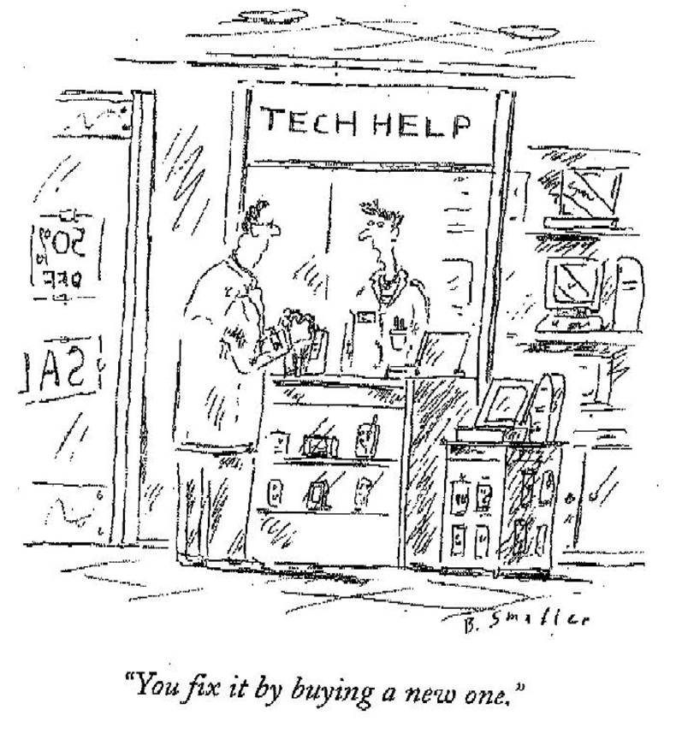
7. Technical Obsolescence
Built to Optimize…

Slide 37
7. Technical Obsolescence
Moore’s Law* 50 years later (*IT systems double in capacity every ~2 years for the same size and cost)
It is almost impossible to keep up with the proliferation of devices, especially user devices (desktops/laptops/tablets, etc.)
Virtualization (earlier topic) is about the only way to deal with this issue – and it can be dealt with
Built to Optimize…

Slide 38
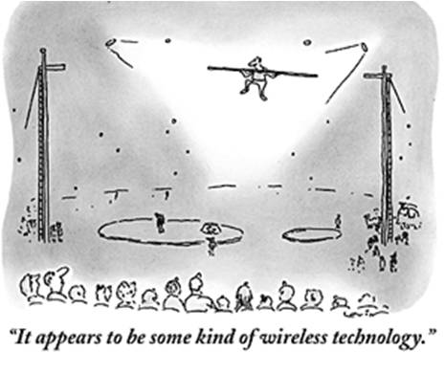
8. Clinical Hypermobility
Built to Optimize…

Slide 39
8. Clinical Hypermobility
Clinicians (including mid-levels, OT/PT, etc.) need solutions that support roaming throughout the facility
2 options:
Laptops/tablets – expensive, easily lost/dropped/stolen
Battery life and “real estate” (screen size) are issues
Workstations – have to have one in each room
Unless using VDI, this is prohibitively expensive to equip and maintain
Built to Optimize…

Slide 40
9. Interoperability
EHR/EMR
Scheduling
PACS
Rx
Labs
Case Mgmt
Supply chain
Email
Messaging
File
Print
Data warehousing
HIE
Analytics/Metrics
RFID
Document Mgmt
Patient education
Disease Registry
Knowledge base
Eligibility
Credentialing
Patient portal
Reporting
Financial
Asset tracking
Payroll
Time/attendance
HR
Training
Compliance
Regulatory
Foundation
Emergency Dept
Inventory
The
“Healthcare IT Tower of Babel”
Built to Optimize…

Slide 41
9. Interoperability
Interoperability between/among systems is always going to be an issue
“Can’t we just get on one system?” (same reason everyone doesn’t just drink Coors or Bud)
Minimize systems and do more with less
Not every software system has to be “best of breed” (another name for no management/governance)
Built to Optimize…

Slide 42
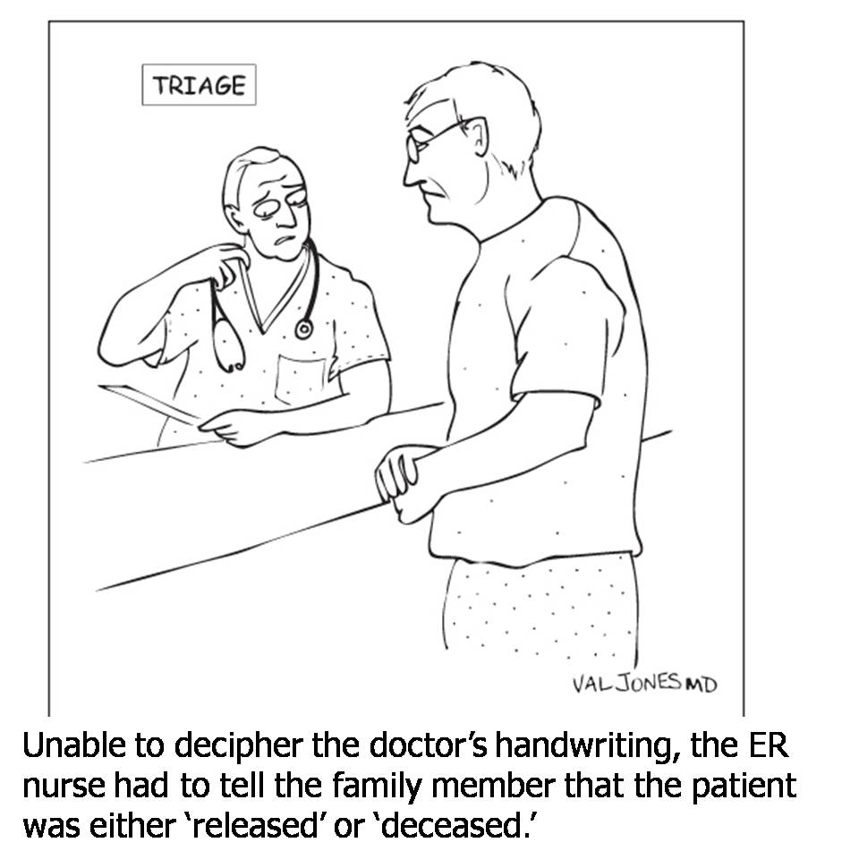
10. Dynamic Clinician Workflow
Built to Optimize…

Slide 43
10. Dynamic Clinician Workflow
Integrated IT solution employing multiple layers of technologies:
Desktop (VDI) and Server Virtualization
Role-based security
2-factor authentication (hospital ID badge + PIN) (something you have plus something you know)
Tap to login/logout (muscle memory)
Built to Optimize…

Slide 44
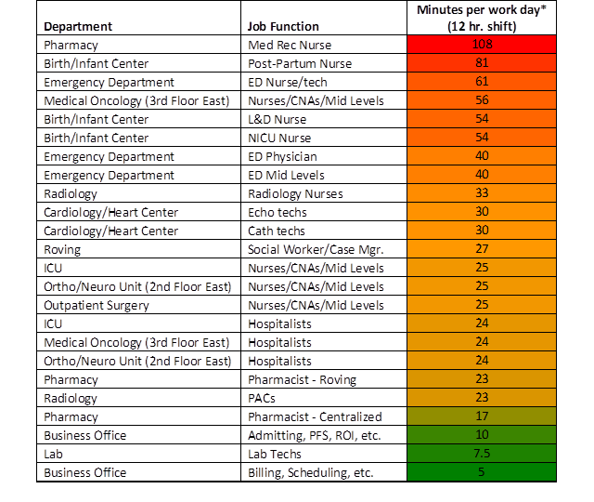
10. Dynamic Clinician Workflow
Actual hospital clinical workflow time study –
time spent just logging in to different applications throughout a 12 hour shift
Built to Optimize…

Slide 45
10. Dynamic Clinician Workflow
Gets clinicians in and out of all their applications in 10 seconds or less
Provides “session persistence” (no lost work)
Floating desktop – can move seamlessly from patient room to patient room and throughout other clinical areas
Handles 2/3 of the IT HIPAA Security specifications, including the ones that are the most difficult
Works with any EHR/EMR and all other apps and websites
Built to Optimize…

Slide 46
10. Dynamic Clinician Workflow
Multi-faceted solution employing multiple layers of technology solutions:
Desktop (VDI) and Server Virtualization
Role-based security
2-factor authentication (ID badge + PIN) (something you have plus something you know)
Tap to login/logout (muscle memory)
Built to Optimize…

Slide 47
10. Dynamic Clinician Workflow
“This is the first time that IT has done something FOR me
…instead of something TO me”
- Chief Medical Officer
Built to Optimize…

Slide 48
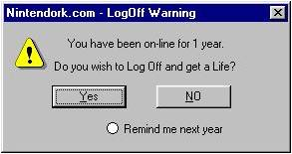
10. Dynamic Clinician Workflow
Built to Optimize…

Slide 49
Contact Info/Further Information
Marion K. Jenkins, PhD, FHIMSS
Chief Strategy Officer
3t Systems
303.991.8296
marion.jenkins@3tsystems.com
www.3tsystems.com
Built to Optimize…

